Slide 1

TARGET FOLDER
SRNTGT080
Railway Distribution Node, SRN
OPAC CLASSIFIED
REL TO CJTF-23
OPAC CLASSIFIED
REL TO CJTF-23

Slide 2

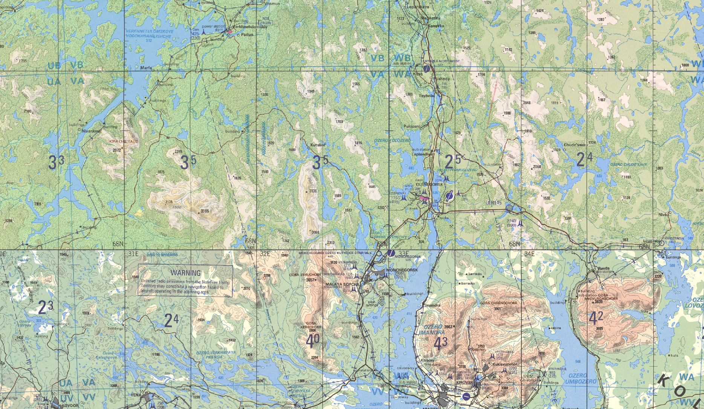
 | RAILWAY DISTRIBUTION NODE, SRN JOINT OPERATIONS GRAPHIC | MAP OVERVIEW | OPAC CLASSIFIED REL TO CJTF-23
 | BE: SRNTGT080 CATCODE: 10 MIDB GEO: N 68 08.373 E 033 18.662 ICOD: 2011-07-01 DOI: 2011-05-12 |  | DECL ON: 2061-01-01(+50 YEARS)
OPAC CLASSIFIED
N
N
RAILWAY DISTRIBUTION NODE
SRNTGT080
.
OPAC CLASSIFIED
REL TO CJTF-23

Slide 3
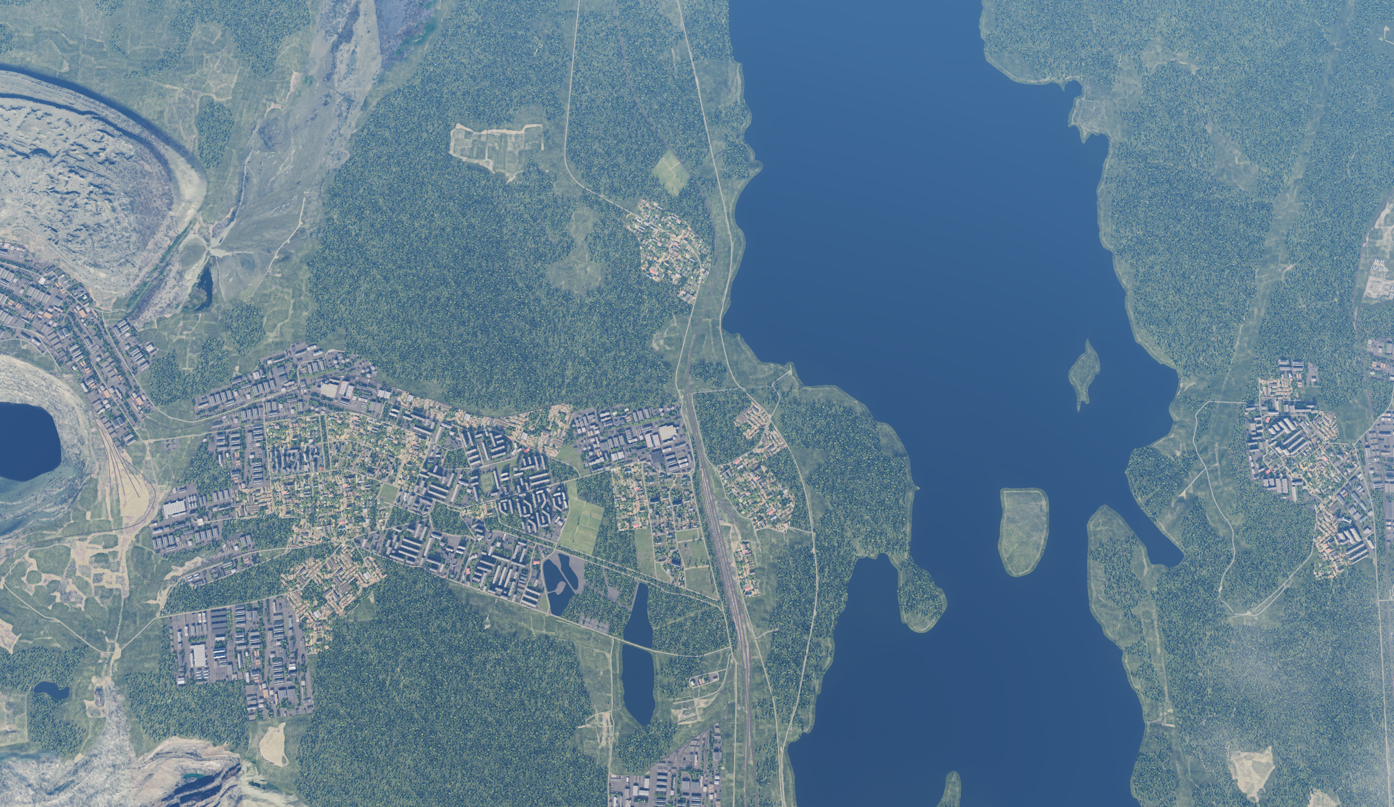
 | RAILWAY DISTRIBUTION NODE, SRN FACILITY OUTLINE GRAPHIC | MAP OVERVIEW | OPAC CLASSIFIED REL TO CJTF-23
 | BE: SRNTGT080 CATCODE: 10 MIDB GEO: N 68 08.373 E 033 18.662 ICOD: 2011-07-01 DOI: 2011-05-12 |  | DECL ON: 2061-01-01(+50 YEARS)
OPAC CLASSIFIED
N
N
RAILWAY DISTRIBUTION NODE
SRNTGT080
OPAC CLASSIFIED
REL TO CJTF-23

Slide 4
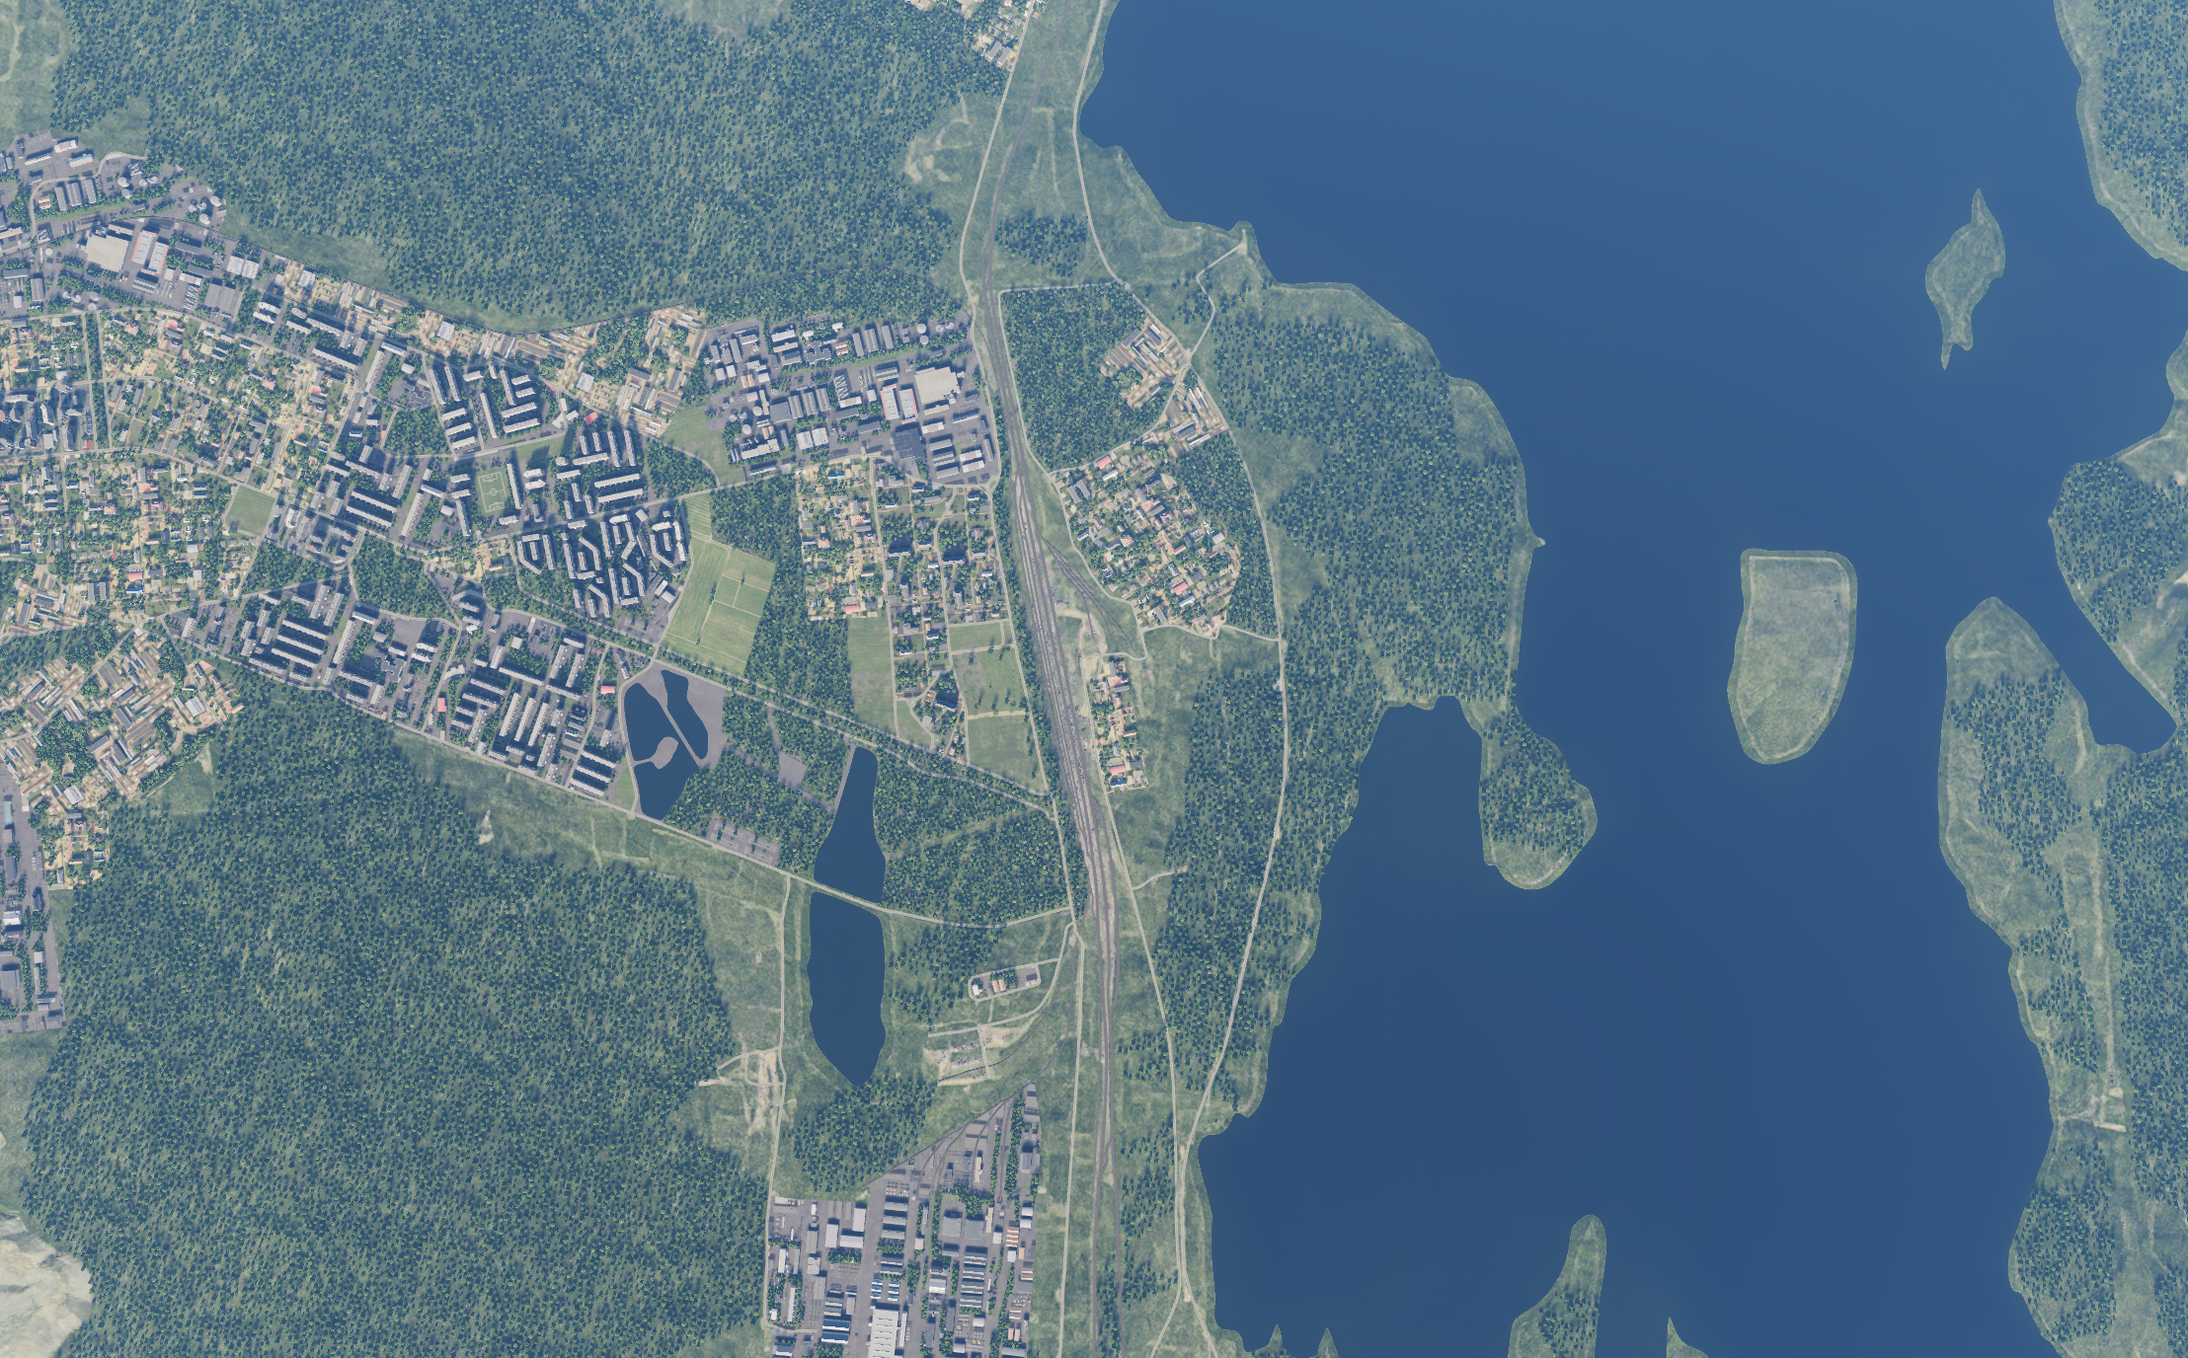
 | RAILWAY DISTRIBUTION NODE, SRN JOINT DESIRED POINT OF IMPACT GRAPHIC | MAP OVERVIEW | OPAC CLASSIFIED REL TO CJTF-23
 | BE: SRNTGT080 CATCODE: 10 MIDB GEO: N 68 08.373 E 033 18.662 ICOD: 2011-07-01 DOI: 2011-05-12 |  | DECL ON: 2061-01-01(+50 YEARS)
OPAC CLASSIFIED
N
DPI: SRNTGT080A
RAILROAD SWITCH
N 68 08.821 E 033 18.647
DPI MSL: 487 FT
N
DPI A
DPI B
DPI: SRNTGT080B
RAILROAD SWITCH
N 68 07.823 E 033 18.751
DPI MSL: 513 FT
OPAC CLASSIFIED
REL TO CJTF-23

Slide 5
 | RAILWAY DISTRIBUTION NODE, SRN WEAPONEERING OPTIONS | MAP OVERVIEW | OPAC CLASSIFIED REL TO CJTF-23
 | BE: SRNTGT080 CATCODE: 10 MIDB GEO: N 68 08.373 E 033 18.662 ICOD: 2011-07-01 DOI: 2011-05-12 |  | DECL ON: 2061-01-01(+50 YEARS)
OPAC CLASSIFIED
DPI | DESCRIPTION | TLE | WARHEAD | GUIDANCE | DESIRED EFFECT | IMPACT ANGLE | FUZING
DPI A | RAILROAD SWITCH | CAT 1 | 2000 Ibs | GPS/LASER | CRATERING | 60˚-90˚ | 10 ms
DPI B | RAILROAD SWITCH | CAT 1 | 500 Ibs | GPS/LASER | CRATERING | 60˚-90˚ | 10 ms
OPAC CLASSIFIED
REL TO CJTF-23
Notes:
TLE 1: 0-6m
TLE 2:7-15m
TLE 3:16-30m
TLE 4:31-91m
TLE 5:92-305
TLE 6: >305m
Warhead: 500Ibs, 1000Ibs, 2000Ibs
Guidance: N/A, Laserguided, INS/GPS

Slide 6
 | RAILWAY DISTRIBUTION NODE, SRN COLLATERAL DAMAGE ESTIMATION GRAPHIC | MAP OVERVIEW | OPAC CLASSIFIED REL TO CJTF-23
 | BE: SRNTGT080 CATCODE: 10 MIDB GEO: N 68 08.373 E 033 18.662 ICOD: 2011-07-01 DOI: 2011-05-12 |  | DECL ON: 2061-01-01(+50 YEARS)
OPAC CLASSIFIED
CER 250M / 820ft
N
N
DPI A
METER | FEET
50 | 165
75 | 246
100 | 328
150 | 492
200 | 656
250 | 820
300 | 984
NCC: FUEL TANKS
890 FT SW FROM DPI A
CER 250M / 820ft
OPAC CLASSIFIED
REL TO CJTF-23
CDE 2, PGM, UNITARY WARHEAD, FAH 050˚- 100˚
Notes:
CDE 1: No restriction
CDE 2: Unitary warhead only (no cluster munition), and FAH restrictions to minimize collateral damage
CDE 3: PGM, unitary
CDE 4: Weaponeering (Fuze setting, FAH, smallest possible bomb)
CDE 5: CJTF-HQ approval needed

Slide 7
 | RAILWAY DISTRIBUTION NODE, SRN COLLATERAL DAMAGES ESTIMATION | MAP OVERVIEW | OPAC CLASSIFIED REL TO CJTF-23
 | BE: SRNTGT080 CATCODE: 10 MIDB GEO: N 68 08.373 E 033 18.662 ICOD: 2011-07-01 DOI: 2011-05-12 |  | DECL ON: 2061-01-01(+50 YEARS)
OPAC CLASSIFIED
COLLATERAL DAMAGES WITHIN A 500M RADIUS
DESCRIPTION |  | CATCODE | MIDB GEOS | LOCATION | REMARKS
FUEL TANKS |  | N/A | N/A | 199˚ / 890ft from DPI A | Can cause secondary exploisions
NO STRIKE ENTITIES WITHIN A 500M RADIUS
NSE ID | DESCRIPTION | CATCODE | MIDB GEOS | LOCATION | REMARKS
 |  | N/A | N/A
OPAC CLASSIFIED
REL TO CJTF-23
Notes:
Location Example: 247˚/ 680ft from DPI D

Slide 8
 | RAILWAY DISTRIBUTION NODE, SRN BATTLE DAMAGE ASSESSMENT GRAPHIC | MAP OVERVIEW | OPAC CLASSIFIED REL TO CJTF-23
 | BE: SRNTGT080 CATCODE: 10 MIDB GEO: N 68 08.373 E 033 18.662 ICOD: 2011-XX-XX DOI: 2011-XX-XX (Or reference ATO Day) |  | DECL ON: 2061-01-01(+50 YEARS)
OPAC CLASSIFIED
POST-STRIKE
PRE-STRIKE
N
N
N
TARGET OBJECTIVE
DAMAGE/CHANGE ASSESSMENT
DPI:SRNTGT080
OPAC CLASSIFIED
REL TO CJTF-23
BDA REMARK: [CLASSIFICATION] [DISSEMINATION] Assessment: Physical Damage/change, Collateral Damage, Functional Damage/change, Munitions Effectiveness, Reattack Recommendation, Additional/Collateral Effects

